Slide 1
Database
Management System
Lecture - 28

Slide 2
Insert
COURSE (crCode, crName, crCredits, prName)
INSERT INTO course VALUES (‘CS-211', ‘Operating Systems’, 4, ‘MCS’)
INSERT INTO course (crCode, crName) VALUES (‘CS-316’, Database Systems’)
INSERT INTO course (‘MG-103’, ‘Intro to Management’, NULL, NULL)

Slide 3
stId | stName | prName | cgpa
S1020 | Sohail Dar | MCS | 2.8
S1038 | Shoaib Ali | BCS | 2.78
S1015 | Tahira Ejaz | MCS | 3.2
S1034 | Sadia Zia | BIT
S1018 | Arif Zia | BIT | 3.0
prName | totSem | prCrdts
BCS | 8 | 134
BIT | 8 | 132
MBA | 4 | 65
MCS | 4 | 64
STUDENT
PROGRAM
crCode | crTitle | crCrdts | prName
CS-616 | Intro to Database Systems | 4 | MCS
MG-314 | Money & Capital Market | 3 | BIT
CS-516 | Data Structures and Algos | 4 | MCS
MG-105 | Introduction to Accounting | 3 | MBA
COURSE
ENROLL
stId | crCode | semName | mTerm | sMrks | fMrks | totMrks | grade | gPoint
S1020 | CS-616 | F04 | 25 | 12.5 | 35 | 72.5 | B- | 2.7
S1018 | MG-314 | F04 | 26.5 | 10.5 | 39 | 76 | B | 3.1
S1015 | CS-616 | F04 | 30 | 10 | 40 | 80 | B+ | 3.5
S1015 | CS-516 | F04 | 32 | 12 | 42 | 86 | A- | 4.1

Slide 4
Select Statement
Maximum used command in DML
Used not only to select certain rows but also the columns
Also used for different forms of product, that is, different joins

Slide 5
Select
Selecting rows from one or more tables
SELECT {*|col_name[,….n]} FROM table_name

Slide 6
Select
Q: Get the data about students
SELECT * FROM student

Slide 7
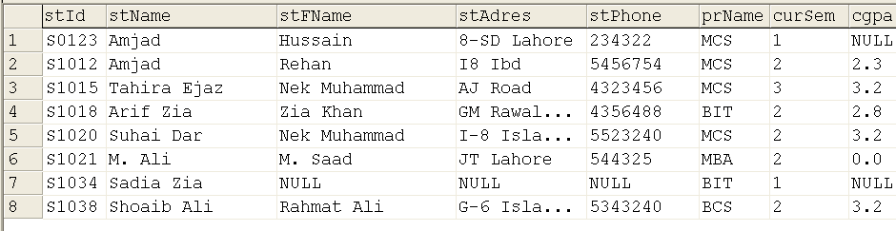

Slide 8
Select
Q: Give the names of the students
with the program name
SELECT stName, prName
FROM student

Slide 9
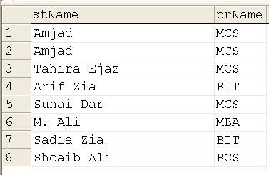

Slide 10
Attribute Alias
Another Name “Urf” for an attribute
SELECT {*|col_name [[AS] alias] [, …n]} FROM tab_name
SELECT stName as ‘Student Name’ , prName ‘Program’ FROM Student

Slide 11
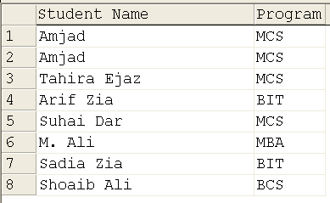

Slide 12
Expression in Select
In the column list we can also give the expression; value of the expression is computed and displayed

Slide 13
Expression Example
Q: Display the total sessional marks of each student obtained in each subject
Select stId, crCode, mTerm + sMrks ‘Total out of 50’ from enroll

Slide 14
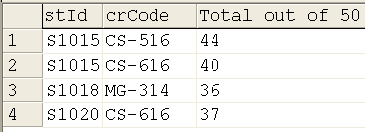

Slide 15
Expression Example
Q: List the names of the students and the program they are enrolled in, in the format “std studies in prg”
SELECT stName + ‘ studies in ‘ + prName FROM student

Slide 16
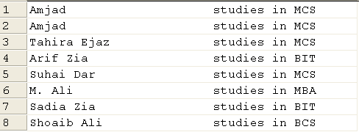

Slide 17
Select Distinct
The DISTINCT keyword is used to return only distinct (different) values

Slide 18
Select Distinct
Just add a DISTINCT keyword to the SELECT statement
SELECT DISTINCT column_name(s) FROM table_name

Slide 19
Select Distinct
Q: Get the program names in which students are enrolled
SELECT prName FROM Student

Slide 20
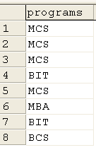

Slide 21
Select Distinct
Q: Get the program names in which students are enrolled
SELECT prName FROM Student
SELECT DISTINCT prName FROM Student

Slide 22
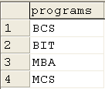

Slide 23
Placing the Checks on Rows
Limit rows or to select certain rows, like,
Programs of certain length, credits; students with particular names, programs, age, places etc.

Slide 24
The WHERE Clause
We used names to limit columns, but rows cannot be named due to the dynamicity
We limit the rows using conditions

Slide 25
The WHERE Clause
Conditions are defined on the values of one or more attributes from one or more tables and placed in the WHERE clause

Slide 26
Database
Management System
Lecture - 28

